Slide 1
PDE4433: ML for Robotics Machine Learning Part 1
Dr. Maha Saadeh

Slide 2
In this lesson … Part 1
Machine Learning
Supervised Learning
Unsupervised Learning
Linear Regression

Slide 3
Recall: Machine Learning
Logistic Regression Decision Trees Random Forest
...
Supervised Learning
Classification
Regression
Machine Learning
Tasks
Algorithms
K-means
K-methoids Sting
A-priori
...
Unsupervised Learning
Clustering
Association Rules
Dr. Giovanni Quattrone, Middlesex University

Slide 4
Recall: Supervised Learning
Train by using labeled data and learn and predict new labels for unseen input data.
Classification is the task of predicting a discrete class label, such as “black,
white, or gray” and “tumor or not tumor”.
Regression is the task of predicting a continuous quantity, such as “weight”, “probability”, and “cost”.

Slide 5
Recall: Unsupervised Learning
Detect patterns and relationships between data without using labeled data.
Clustering algorithms: Discover how to split the data set into a number of groups such that the data points in the same groups are more similar to each other compared to data points in other groups

Slide 6
Supervised Learning
True pattern Noise

Slide 7
Supervised Learning
The main goal of supervised learning is study, build and use algorithms that can
learn from data to make predictions
What do we want to learn?
We want to learn the true pattern hidden in the data and use it to make predictions.
However this true pattern is unknown, we have n observations (our dataset –
called training dataset).

Slide 8
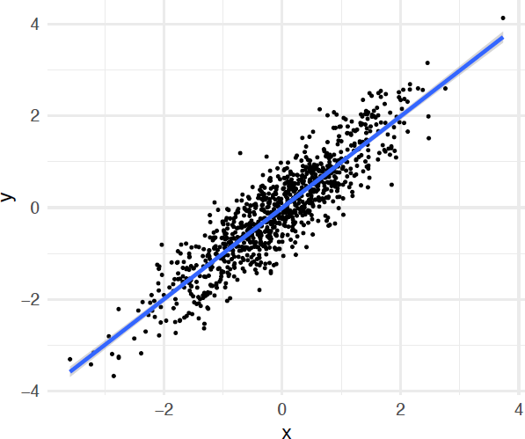
Supervised Learning
As an example, imagine to have the data on the right.
-We can use this data to learn the true
pattern:
f(x) = x → True pattern
But we can see that the data contains also some noise (ε).
y = f(x) + ε

Slide 9
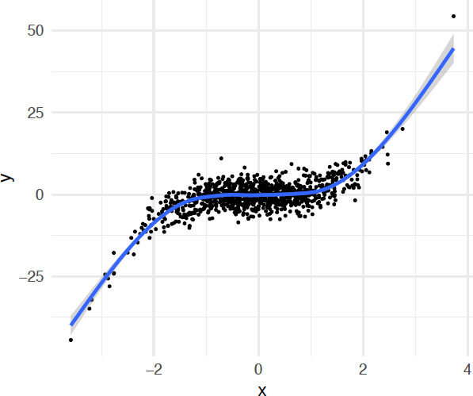
Supervised Learning
As an example, imagine to have the data on the right.
We can use this data to learn the true pattern:
f(x) = x³ → true pattern
We can see that the data contains also some
noise (ε).
y = f(x) + ε

Slide 10
Supervised learning
Therefore, we can conceptually imagine that our data, composed by 𝑛 independent observations, always contains the following two components:
Data contains: true pattern + noise
Goal of supervised learning is to use the available observations to learn the unknown true pattern so to create a model capable of making predictions on new unseen data.
Dr. Giovanni Quattrone, Middlesex University

Slide 11
Supervised learning
Our data is composed by 𝑛 observations.
Each observation contains an independent value of
𝒙 = [𝑥₁,..., 𝑥_{m} ] ^{T} (𝑚 independent variables)
𝑦 (1 continuous dependent variable)
Regression
𝑦
is continuous
We imagine that our data contains a true
pattern 𝑓 𝒙 and some noise 𝜀:
𝑦 = 𝑓(𝒙) + 𝜀
Dr. Giovanni Quattrone, Middlesex University

Slide 12
Supervised learning
Our data is composed by 𝑛 observations.
Each observation contains an independent value of
𝒙 = [𝑥₁,..., 𝑥_{m} ] ^{T} (𝑚 independent variables)
𝑦 (1 discrete dependent variable)
Classification
𝑦
is discrete
We imagine that our data contains a true
pattern 𝑓 𝒙 and some noise 𝜀:
𝑦 = 𝒟( 𝑓(𝒙) + 𝜀 )
Dr. Giovanni Quattrone, Middlesex University

Slide 13
Recall: vectors and matrices
Most common form of data organization for machine learning is a 2D array, where
vector
 | Refund | Marital Status | Taxable Income | Cheat
 | Yes | Single Married Single | 125K 100K 70K | No No No
 | No
 | No
 | Yes | Married | 120K | No
 | No | Divorced Married Divorced Single Married Single | 95K 60K 220K 85K 75K 90K | Yes No No Yes No Yes
 | No
 | Yes
 | No
 | No
 | No
rows represent observations (records, items,
data points)
columns represent attributes (features,
variables)
Natural to think of each sample as a vector
of attributes, and whole array as a matrix
10
matrix
Dr. Giovanni Quattrone, Middlesex University

Slide 14
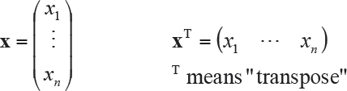
Vectors
Definition: an n-tuple of values (usually real numbers).
n referred to as the dimension of the vector
n can be any positive integer
Can be written in column form or row form
Column form is conventional
Vector elements referenced by subscript
Dr. Giovanni Quattrone, Middlesex University

Slide 15
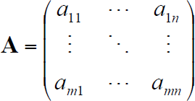
Matrices
Definition: an m x n two-dimensional array of values (usually real numbers).
m rows
n columns
Matrix referenced by two-element subscript
first element in subscript is row
second element in subscript is column
example: A_{2,4} or a_{2,4} is element in second row, fourth column of A
Dr. Giovanni Quattrone, Middlesex University

Slide 16
Linear Regression
Supervised Regression
It is used to establish a relationship between an input variable(X) (or more) and output
variable(Y).
Input with single independent variable is mainly called as linear regression and input with more than one independent variable is called as multiple linear regression.
The input variables are the independent variables and output variable is the dependent variable

Slide 17
Linear Regression
Linear regression relies on the assumption that the hidden true pattern is
linear.
Equation of the line: Y= b₀ + b₁.X where b₁ is the slope of the line and b₀ also called as weights.
is the intercept of Y and they are
Our end goal is to draw a line between X(independent) and Y(dependent)
which fine tunes the relationship between them.
It is called regression because the dependent variable y is continuous. It would have been called classification if y was nominal.

Slide 18
Linear Regression
Multiple Variables
Let's assume that our training data contains n independent observations, each observation has continuos dependen variable y and m continuos independen variables x1, ..., xm.
The true pattern f(x) = b + b x + ... + b x
linear Equation with multiple independent variables
0 1 1 m m
But remember that we also have noise:
Y = b₀ + b₁ x₁ + ... + b_{m} x_{m} + ε
We need to infer the unknown parameters b₀ , b₁ ... b_{m}

Slide 19
Error
The output which is calculated based on the estimated parameters is called the
predicted output Y’
But remember, this is a supervised learning, so the actual output that we have in each
observation is provided as
Based on this, the error is
Y - Y’ = ε
The actual output – the predicted output

Slide 20
Error
The output which is calculated based on the estimated parameters is called the
predicted output Y’
But remember, this is a supervised learning, so the actual output that we have in each
observation is provided as
Based on this, the error is
Y - Y’ = ε
We need to minimize this value

Slide 21
Linear Regression
Single variable:
If we want to predict the tip amount based on the previous tips and the bill amount. Assume the following data, what is the possible predicted next tip amount?
25
Give estimation for
Tip # 6
# | Tip $ | Bill $
1 | 10 | 100
2 | 5 | 50
3 | 20 | 220
4 | 7.5 | 90
5 | 12.5 | 150
6 | ?? | 40
20
15
Tips
10
5
0
0
40
80
120
160
200
Bill

Slide 22
Linear Regression
Single variable:
If we want to predict the tip amount based on the previous tips and the bill amount. Assume the following data, what is the possible predicted next tip amount?
We can notice the relation here, data follow a line
25
# | Tip $ | Bill $
1 | 10 | 100
2 | 5 | 50
3 | 20 | 220
4 | 7.5 | 90
5 | 12.5 | 150
6 | ?? | 40
20
15
Tips
10
5
0
0
40
80
120
160
200
Bill

Slide 23
Linear Regression
Single variable:
If we want to predict the tip amount based on the previous tips and the bill amount. Assume the following data, what is the possible predicted next tip amount?
25
# | Tip $ | Bill $
1 | 10 | 100
2 | 5 | 50
3 | 20 | 220
4 | 7.5 | 90
5 | 12.5 | 150
6 | ?? | 40
Which regression line is the best?
20
15
Tips
10
5
0
0
40
80
120
160
200
Bill

Slide 24
Linear Regression
Single variable:
If we want to predict the tip amount based on the previous tips and the bill amount. Assume the following data, what is the possible predicted next tip amount?
25
# | Tip $ | Bill $
1 | 10 | 100
2 | 5 | 50
3 | 20 | 220
4 | 7.5 | 90
5 | 12.5 | 150
6 | ?? | 40
Which regression line is the best?
The one with the
minimum error
Tips
20
15
10
5
0
0
40
80
120
160
200
Bill

Slide 25
Linear Regression
Single variable:
If we want to predict the tip amount based on the previous tips and the bill amount. Assume the following data, what is the possible predicted next tip amount?
25
𝝁_{𝑩𝒊𝒍𝒍} = 𝟏𝟐𝟐
The regression line MUST go cross the centroid point
# | Tip $ | Bill $
1 | 10 | 100
2 | 5 | 50
3 | 20 | 220
4 | 7.5 | 90
5 | 12.5 | 150
6 | ?? | 40
20
Centroid
Centroid point =
15
𝝁_{𝑻𝒊𝒑} = 𝟏𝟏
(𝜇 , 𝜇 )
𝐵𝑖𝑙𝑙 𝑇𝑖𝑝
Tips
10
5
0
0
40
80
120
160
200
Bill

Slide 26
Linear Regression
Single variable:
If we want to predict the tip amount based on the previous tips and the bill amount. Assume the following data, what is the possible predicted next tip amount?
25
𝝁_{𝑩𝒊𝒍𝒍} = 𝟏𝟐𝟐
# | Tip $ | Bill $
1 | 10 | 100
2 | 5 | 50
3 | 20 | 220
4 | 7.5 | 90
5 | 12.5 | 150
6 | ?? | 40
20
15
𝝁_{𝑻𝒊𝒑} = 𝟏𝟏
Tips
10
5
𝑌′ = 0.386 + 0.087𝑋
0
0 40 80 120 160 200
Bill

Slide 27
Linear Regression
Single variable:
If we want to predict the tip amount based on the previous tips and the bill amount. Assume the following data, what is the possible predicted next tip amount?
25
𝝁_{𝑩𝒊𝒍𝒍} = 𝟏𝟐𝟐
# | Tip $ | Bill $
1 | 10 | 100
2 | 5 | 50
3 | 20 | 220
4 | 7.5 | 90
5 | 12.5 | 150
6 | ?? | 40
𝑌′ = 0.386 + 0.087𝑋
𝑌′ = 0.386 + 0.087 ∗ 40
20
15
𝑌′ = 3.866
𝝁_{𝑻𝒊𝒑} = 𝟏𝟏
Tips
10
5
0
0
40
80
120
160
200
Bill

Slide 28
Linear Regression
Single variable:
If we want to predict the tip amount based on the previous tips and the bill amount. Assume the following data, what is the possible predicted next tip amount?
25
𝝁_{𝑩𝒊𝒍𝒍} = 𝟏𝟐𝟐
# | Tip $ | Bill $
1 | 10 | 100
2 | 5 | 50
3 | 20 | 220
4 | 7.5 | 90
5 | 12.5 | 150
6 | 3.866 | 40
𝑌′ = 0.386 + 0.087𝑋
𝑌′ = 0.386 + 0.087 ∗ 40
20
15
𝑌′ = 3.866
𝝁_{𝑻𝒊𝒑} = 𝟏𝟏
Tips
10
5
0
0
40
80
120
160
200
Bill

Slide 29
Linear Regression
How our model fit to the given data?
# | Tip $ | Bill $
1 | 10 | 100
2 | 5 | 50
3 | 20 | 220
4 | 7.5 | 90
5 | 12.5 | 150
6 | ?? | 40
25
20
15
10
5
0
0
40
80
120
160
200
Bill

Slide 30
Linear Regression
How our model fit to the given data?
Find the error
# | Tip $ | Bill $
1 | 10 | 100
2 | 5 | 50
3 | 20 | 220
4 | 7.5 | 90
5 | 12.5 | 150
6 | ?? | 40
25
25
+0.4
20
20
+9
15
15
+1.5
+0.9
10
𝝁 = 𝟏𝟏
10
-
0.93
Tips
-1
-6
-3.5
-
0.26
5
5
-
0.71
0
0
0
1
2
3
4
5
6
0
40
80
120
160
200
Bill

Slide 31
Accuracy of the model
The quality of a linear regression model is typically assessed using the following metrics:
R-squared
MSE

Slide 32
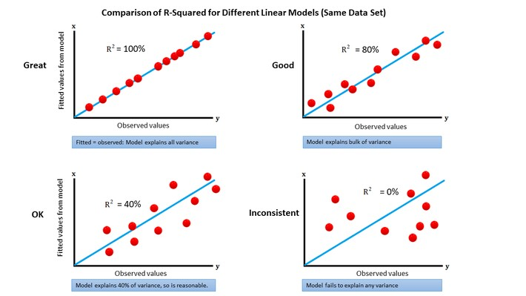
R-Squared
R-squared value is a statistical measure of how close the data is, fitted to the regression line. It is a value between 0 and 1, that measures how well our regression line fits our data.
The percentage of variation explained by the relationship between two
variables.

Slide 33
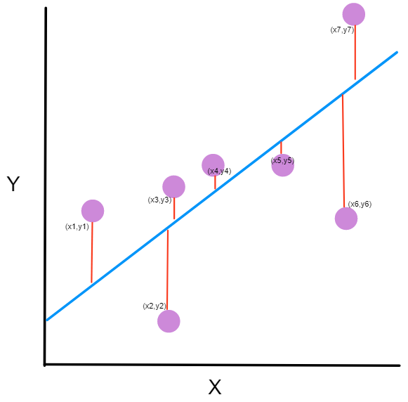
MSE
The mean squared error (MSE) measures the average
of the squares of the errors ε_{i}:
MSE =
σ 𝐸²
𝑛
As usual, n denotes the number of observations. Small MSE indicate good fit, whereas high MSE indicate bad fit.

Slide 34
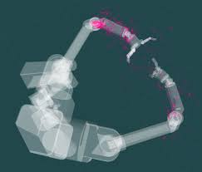
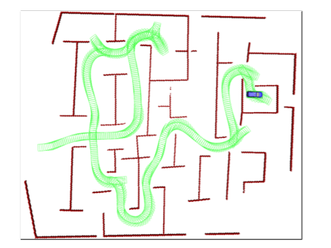
Regression for Robotics
Robot arm position estimation
Path time (arriving time) estimation
Traffic congestion waiting time estimation
More ?
Practical Search Techniques in Path Planning for Autonomous Driving by Dmitri Dolgov, Sebastian Thrun, Michael Montemerlo, and James Diebel. American Association for Artificial Intelligence

Slide 35
In this lesson … Part 2
Python Example
Multi-variable regression

